Slide 1

Stage 6 Uneven Flow Course Designer: Ken Wang
Uneven Flow (inspired by Area 4 Even Flow stage) is a 25 round, 125 point, COMSTOCK Long course. There are 12 USPSA targets and 1 steel target. The best 2 hits per target will score. Steel must fall to score.
The handgun start position is standing with feet touching the start stick with wrists below belt. Handgun is loaded and holstered. PCC start position is standing with feet touching the start stick with PCC loaded, stock on belt, safety on.
On the audible start signal, engage all targets from within the shooting area.

Slide 2
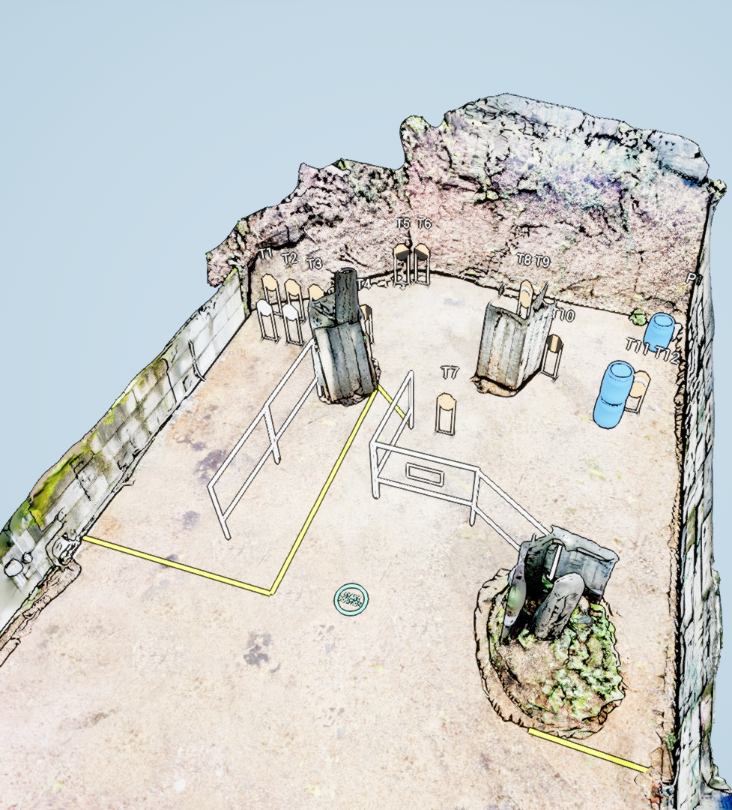
 | Stage 6 Uneven Flow Course Designer: Ken Wang

